Slide 1
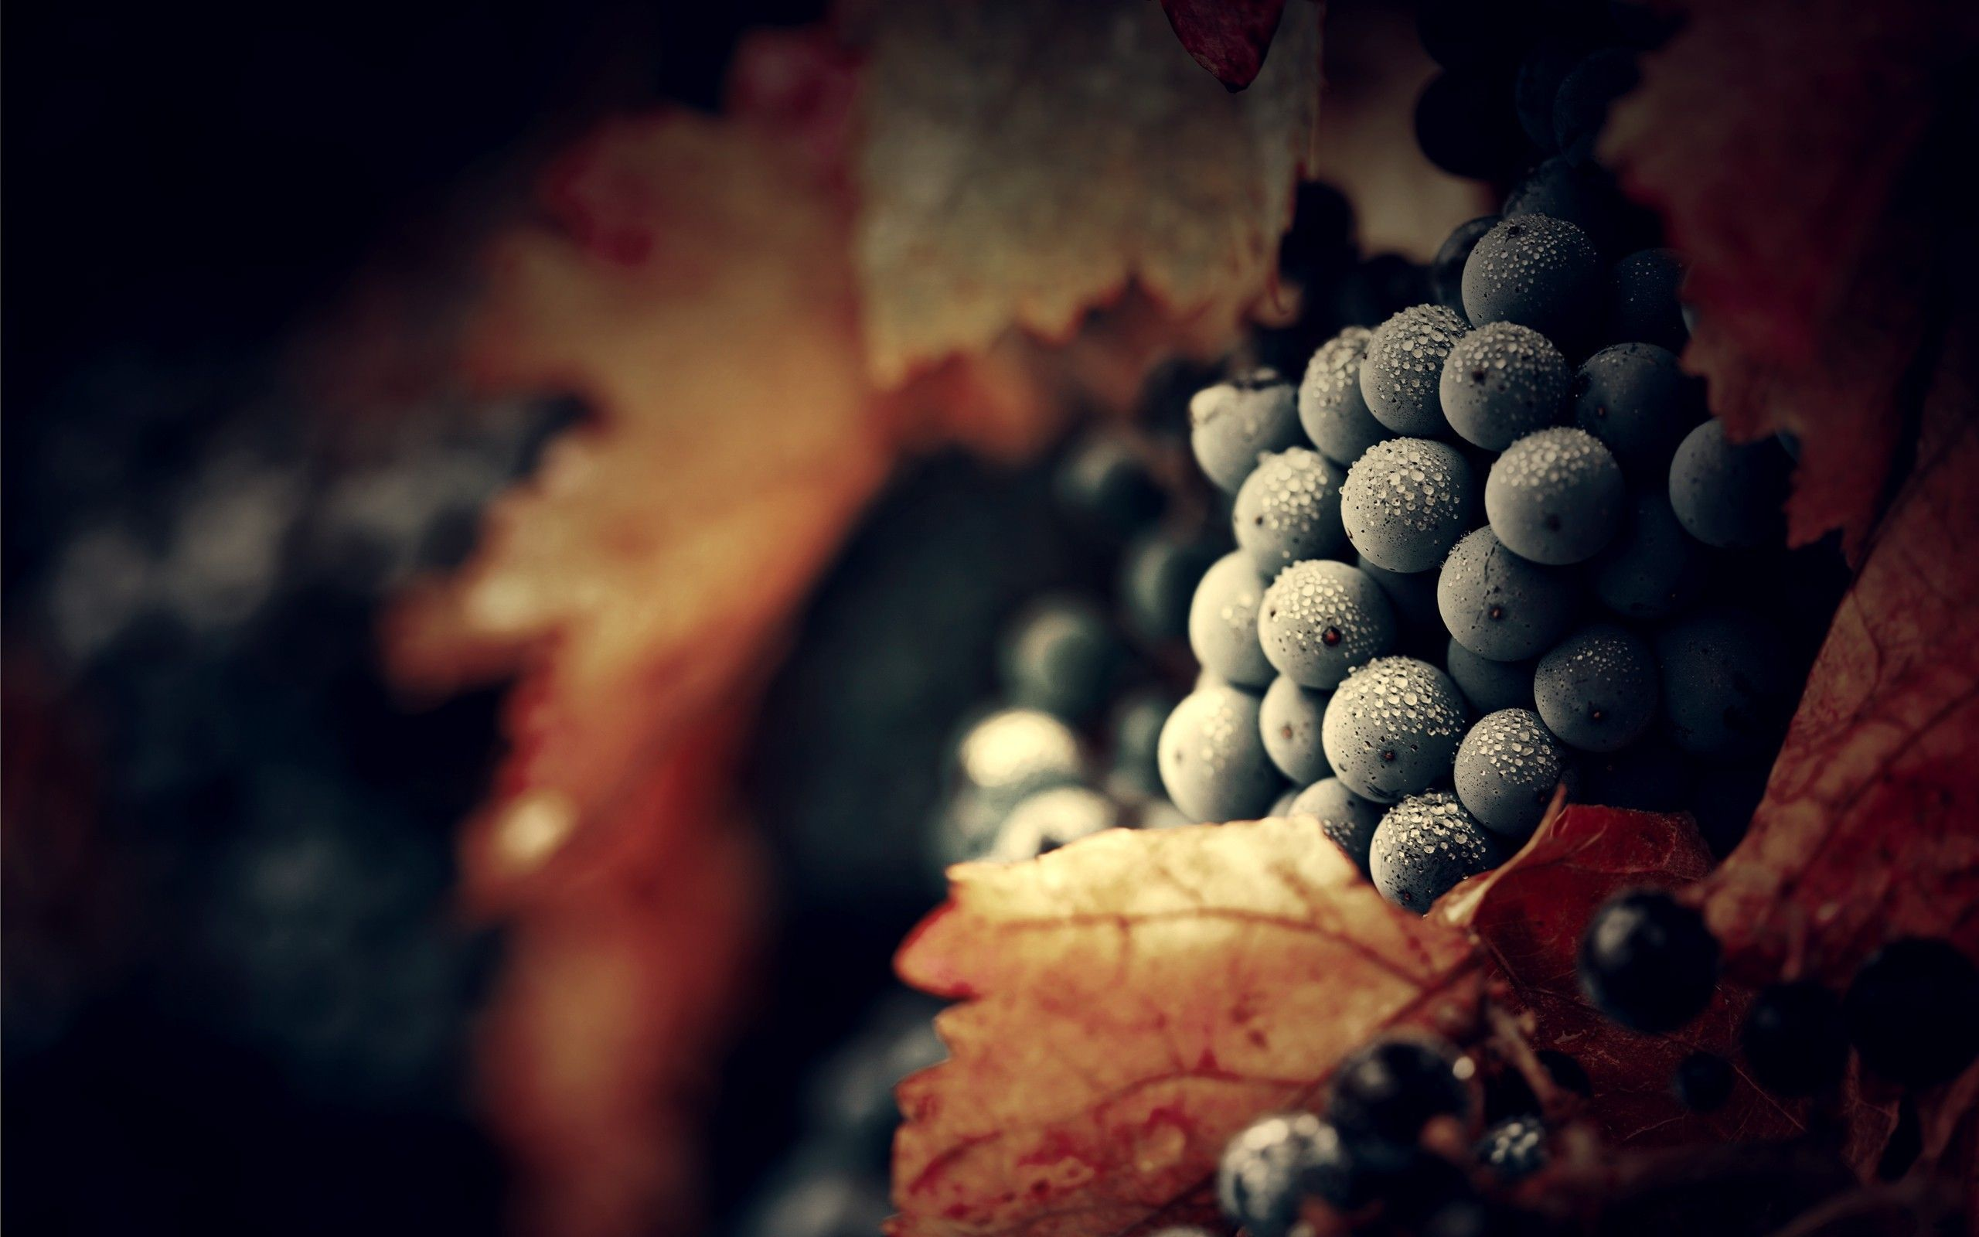
Vine SOS for endangered traditional vine varieties

Slide 2
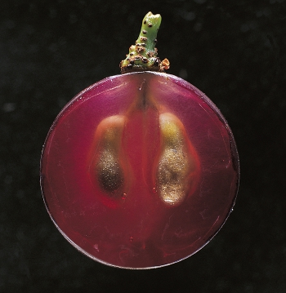
Traditional local varieties in terms of climate change and invasive plants.

Slide 3

Local varieties and climate change
A new study says more than half of the world's vineyards could become unviable if the planet warms by two degrees Celsius, but replacing grape varieties could help the sector.
Swapping grape varieties can significantly offset damage that would be inflicted on some wine regions by higher temperatures linked to climate change, says a study published in the Proceedings of the National Academy of Sciences USA (PNAS).
Up to 56% of current wine growing land may no longer be suitable for vineyards if the planet warms by two degrees Celsius.
That figure rises to 85% if warming hits four degrees, says the study, which used historical growing season data for 11 grape varieties, including Cabernet Sauvignon, Pinot Noir and Chardonnay, to create its model.

Slide 4
Local varieties and climate change
The research acknowledges the financial, cultural and legal hurdles to, say, replacing the imported varieties with typical, local for the respective territory varieties improve the success. This is due to the natural ability of local varieties to adapt to climate change in their own environment.
Cooler wine regions, such as New Zealand, the Pacific Northwest and Germany, would be relatively unaffected in this scenario.
Nature intervenes is in struggle for the survival of varietal diversity with modern popular wines. In the regions that have a warming climate, there is more and more talk about methods for:
prevention of sunburn
elevated sugars in the fruit
methods for stabilizing the must at high outdoor temperatures
ways to protect the root system of Vitis in dry soils and others

Slide 5
Local varieties and climate change
The native species of Vitis Vinifera do not need to build complete protection to the changing external environment, they adapt only to the changes that are taking place at the moment. For example, the Chardonnay variety in the region of South Sakar or Drama must build adaptability to all elements of the environment - soil, climate, denudation, while the Keratsuda variety must adapt only to the increased 2-4 degrees C, and related new parameters of soil moisture. The local varieties for a given region are many times superior to the ability to cope with biotic stress.
From a practical perspective, different forms of wild grapes are natural prerequisite for selection of forms with increased resistance to biotic and abiotic stress and other economically valuable qualities that are important for the genetics and breeding. Detailed examination of within species richness and diversity of biotypes of wild vines is a source of enrichment of the gene pool in the grapevine. Over the last few decades, interest in wild grapes grow considerably, as regarding their use for various breeding purposes as well as in conjunction with '' reading '' of the grapevine genome at molecular level.

Slide 6
Local varieties and climate change
High temperatures force Vitis to produce more sugars, save energy and water in the form of oils and vitamins, but the weight of the molecule does not lead to high fruit quality, but to the accumulation of bitterness.
Warm winds dry all parts of the vine, causing a maximum protective reaction from it. Increasing tannins, acids remain in the hard parts, and fat does not accumulate enough in the seed of the fruit.
Vitis Vinifera suffers from changes in the external environment as a whole, not in parts. The intense temperature amplitude stresses the whole vine, forcing it to use acids to maintain flexibility.
The leaf mass, the root system and the stem during the different phenological phases need a water reserve, which is often missing. The leaf mass first affects the mineral deposits and in particular calcium.

Slide 7
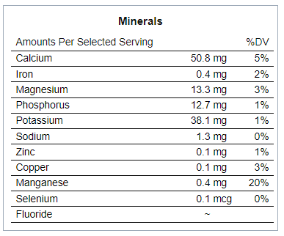
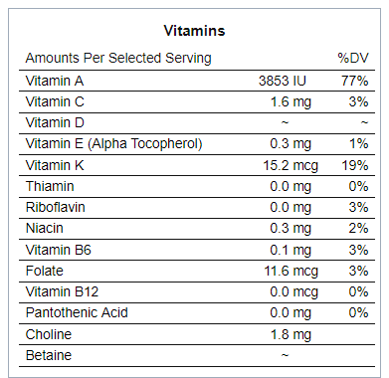
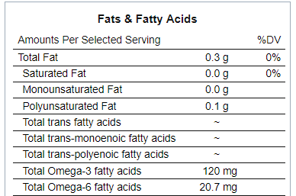
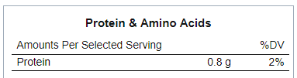
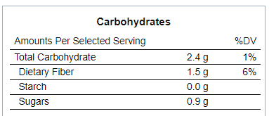
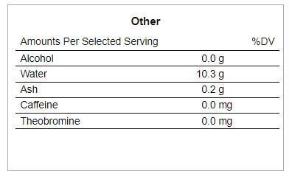
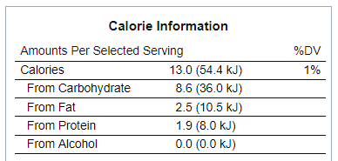
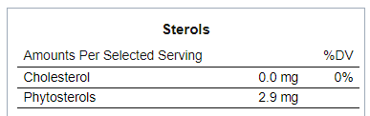
Local varieties and climate change
Nutrition information of a leave from Vitis vinifera. The examination of the contents of a leaf of Vitis Vinifera is based on 14 grams of leaf at full maturity.

Slide 8
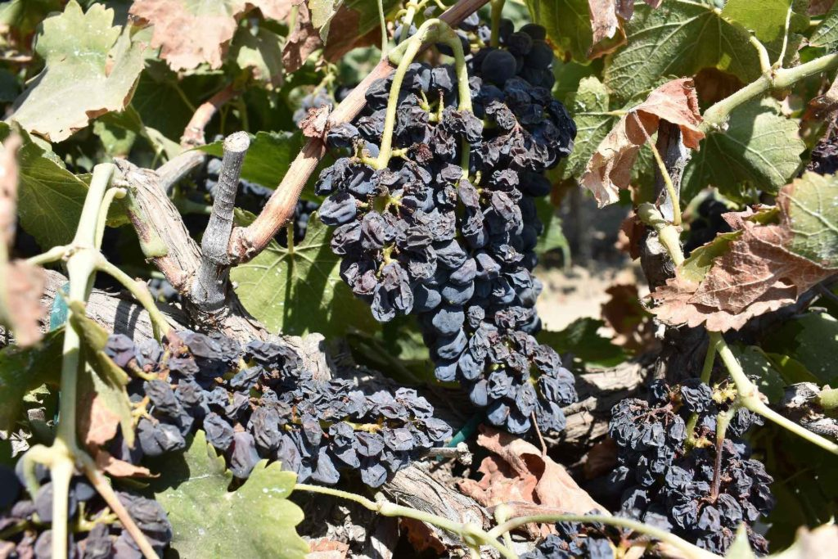
Local varieties and climate change
Sunburn of Syrah

Slide 9
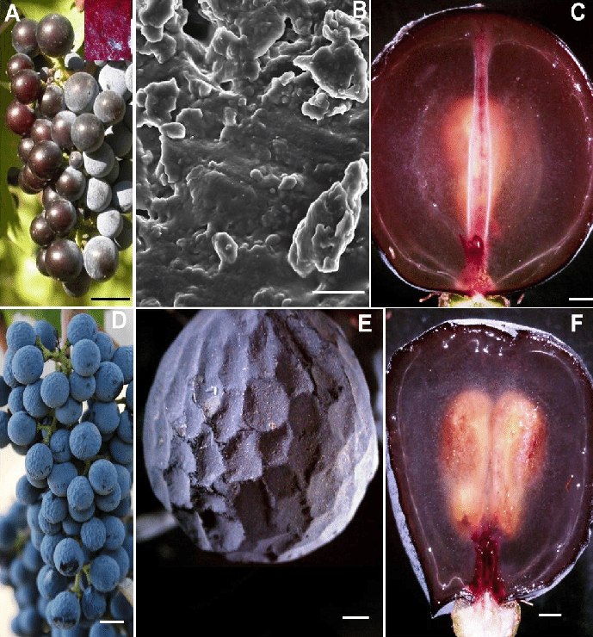
Local varieties and climate change
An understanding of physiological disorders associated with ripening of fruits triggered by abiotic stress relies on anatomical and physical and chemical analyses, as it provide insights into their origin and probable causes. The objective of this analysis is to analyze different ripening disorders of grape Vitis vinifera L. berries.
Picture of (A) A cluster of sunburned berries (B) A scanning electron micrograph of the exposed rough surface revealing amorphous mass of degraded wax platelets; (C) A sunburned berry with bilateral symmetry (D) Photograph of a cluster of berries with prolonged dehydration; (E) A single dehydrated berry from (D), showing the distinct polygonal indentations throughout the outer mesocarp zone resembling that of a golf ball; and (F) A dehydrated berry with vascular tissues, and seeds. Scale bars : 10 mm (A), (C) - (F), 3 µm (B). AVB-Axial vascular bundle, DE-Distal end, PE-Proximal end, PVBperipheral vascular bundle, S-Seed

Slide 10
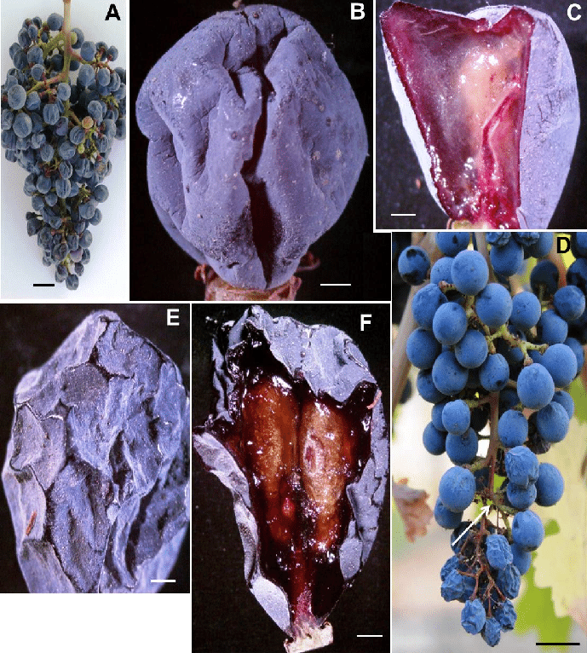
Local varieties and climate change
Picture of (A) A cluster of berries afflicted with berry shrivel attached to chlorophyllous rachis via chlorophyllous pedicel (B) A berry afflicted with berry shrivel (C) A berry afflicted with berry shrivel showing collapsed mesocarp and healthy seed, (D) Photograph of a cluster showing healthy proximal part with spherical berries with necrotic rachis and pedicels, (E) Berry displaying shriveled pericarp resembling a raisin, and (F) Berry displaying dried up mesocarp and healthy seeds. Scale bars: 10 mm (A), (D), 3 mm (B), 1 mm (C) - (F).

Slide 11
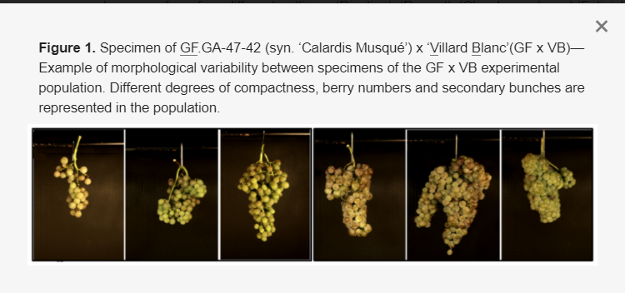
Local varieties and climate change
Changes in the phenotype under the influence of depleted soil due to dehydration.
The figure shows the morphological changes with constant exposure to dehydrated soil in the variety Muscat Petit Gri. In the cross-border region Bulgaria - Greece, the variety that would withstand abiotic stress is Tamyanka. It is a local representative of the indigenous varieties of high economic, organoleptic and historical value.

Slide 12
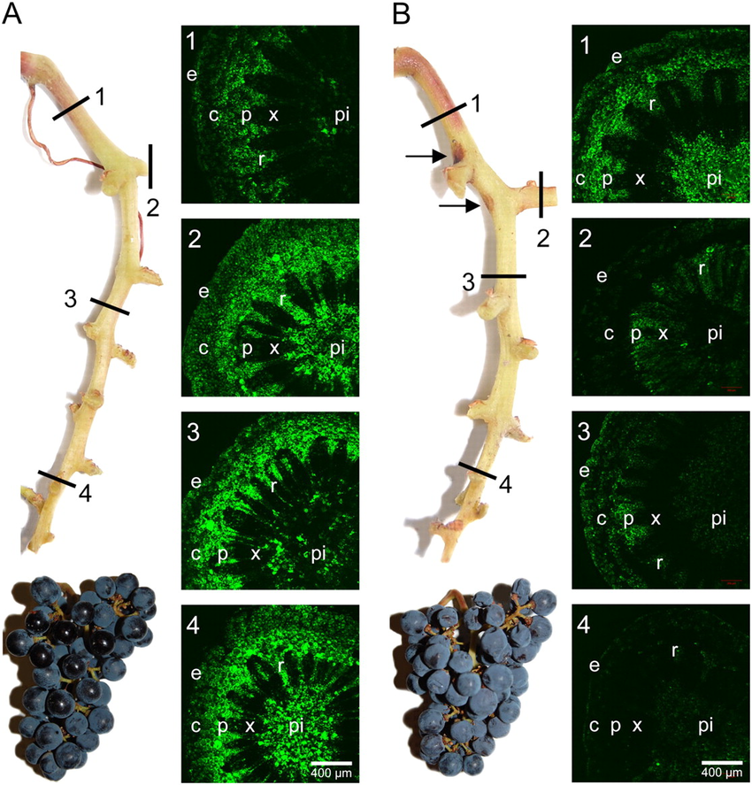
Local varieties and climate change
Negative changes in Syrah's RNA due to a change in agrometeorological conditions in the field by 1.03 degrees C, for a period of 6 months.
The figure shows the process of dehydration of the berry, in which it loses its valuable qualities, and hence the wine that will be produced from it. In the cross-border region Bulgaria-Greece the variety Mavrud is local representative of the autochthonous varieties with high economic, organoleptic and historical value.

Slide 13
Local varieties and climate change
The issue of "agrometeorological drought" is being raised across Europe, and areas that have been characterized by drier climatography for centuries now face the need to provide additional irrigation water. Other dramatic impacts of climate change in warm viticulture areas include: increased advancement and compression of all phenological stages. According to Sadras and Petrie number of days elapsing between average harvest dates for Chardonnay and Cabernet Sauvignon cultivars has decreased from 21 days at the beginning of the 90 s to only 9 days in 2019. The increasing frequency of extreme events that have a serious effect on the profitability of viticulture is also a factor that should not be overlooked. A suitable example is recurrent frost damage fostered by very early bud push and, afterward, a longer time window during which a damaging frost event might still occur. Considering the scenario with an increase in global temperature by 2 degrees C, it will be increasingly difficult to achieve an ideal composition of grapes for the production of specific wines with established taste.

Slide 14
Local varieties and climate change
In the case of white varieties, and especially to those grown to produce sparkling or spumante wines, the challenge thrown by climate change is great. If the wine target is a sparkling, a desirable grape composition at harvest is often as follows: a total soluble concentration (TSS) between 20 and 21 ° Brix, titratable acidity (TA) ≥ 6,5–7,0 g / L, pH ≤ 3.2 then these values require constant climatographic characteristics in order to achieve consistency in taste. Among such desired characteristics, increased heat summations – including also a marked increase of night temperatures – primarily endanger the maintenance of adequate acidity. It is well established that, while tartaric acid concentration is essentially unaffected by temperature, the rapid loss in malic acid starting at the onset of berry softening is mainly temperature driven.
Local traditional wine varieties in the face of changing climatic conditions and invasive plants have an advantage that needs to be appreciated. They can support wine production through a stable and constant harvest and higher disease resistance. The only problem is that they are not popular, and that fact can be changed.
Considering the topic, positives excel such :
Sustainability
Adaptability
Economic benefit
Persistence

Slide 15
Thank you for your attention!

